Slide 1
3u3 CubeSat Instrument Response
By: Daniel Abel
09/08/2023

Slide 2
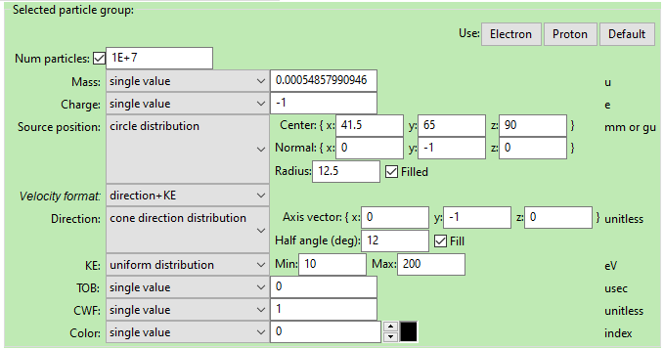
Starting Population Definition for 0deg centerline

Slide 3
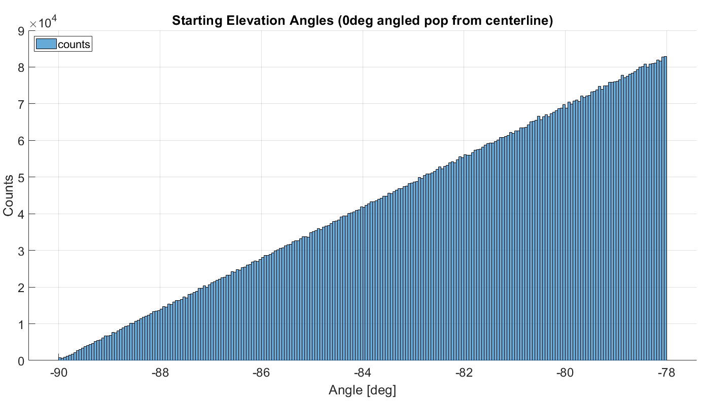
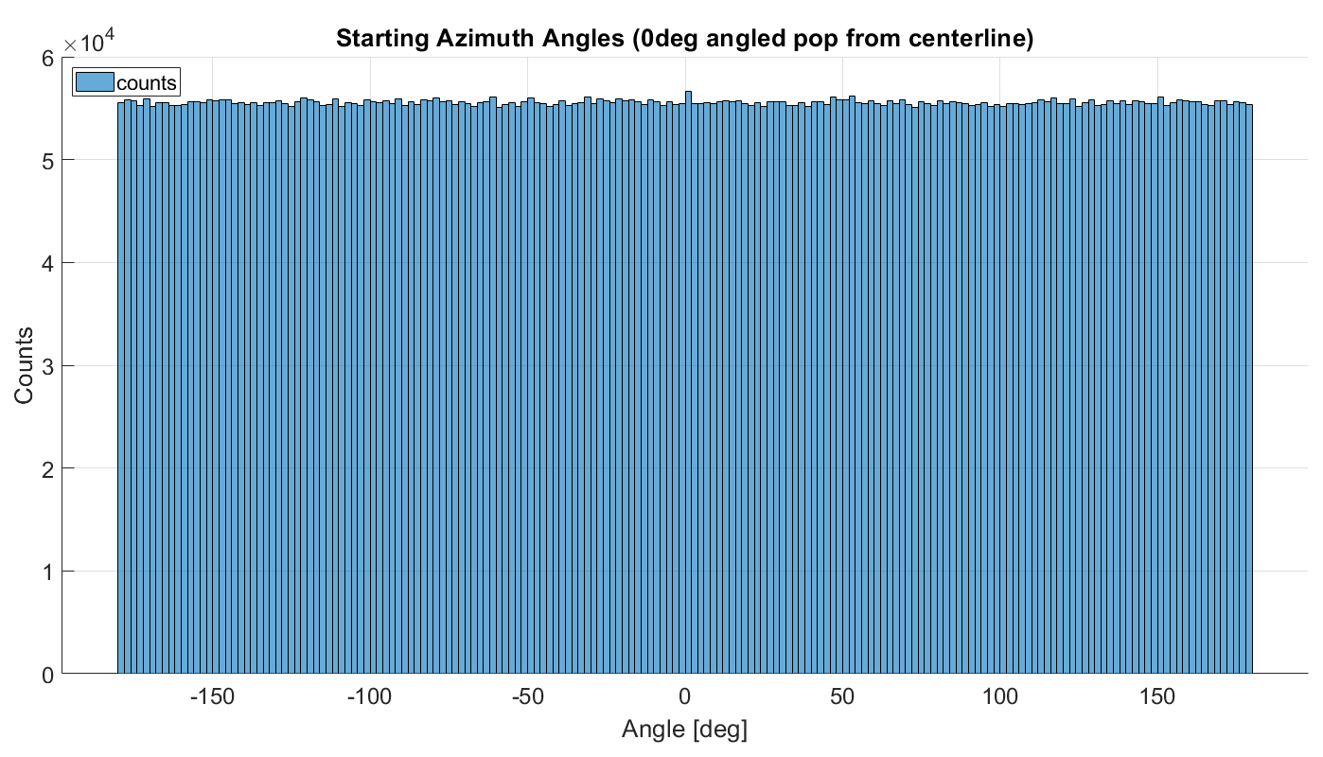
Starting Population Definition Cont. for 0deg from instrument centerline
These graphs are for the 10eV population*
The other particle populations are not identical but have the same definition in SIMION besides energy

Slide 4
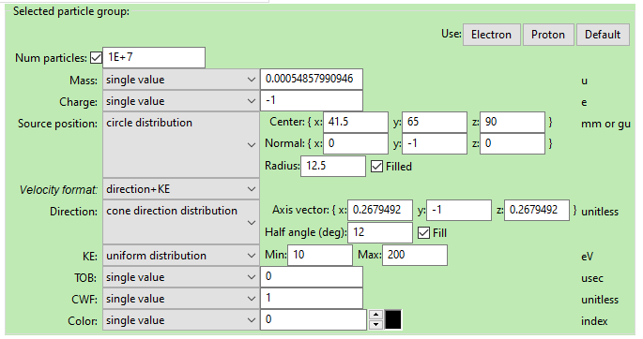
Starting Population Definition for 20.75deg centerline

Slide 5
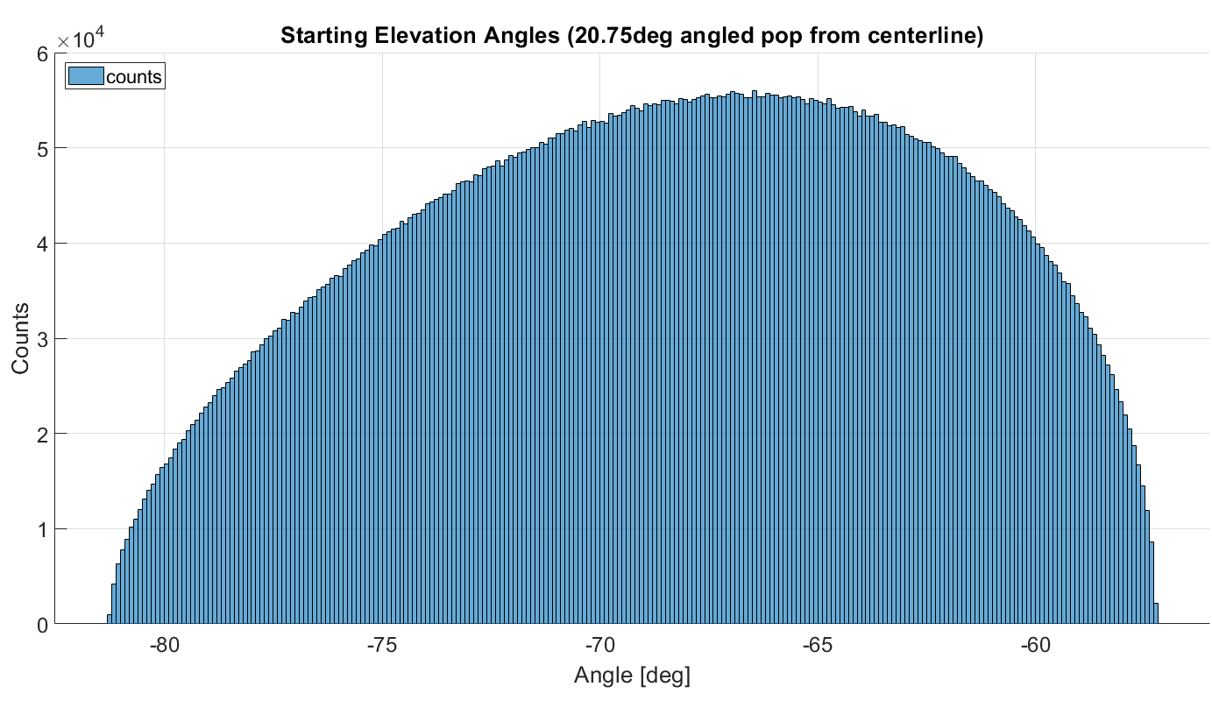
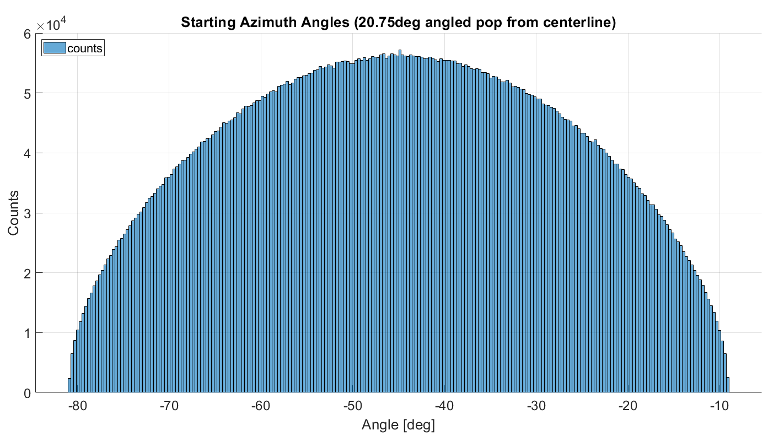
Starting Population Definition Cont. for 20.75 deg from instrument centerline

Slide 6
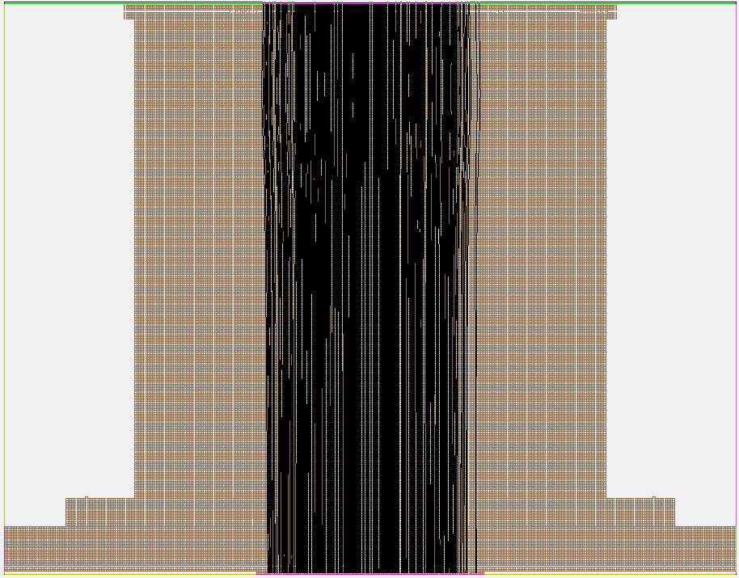
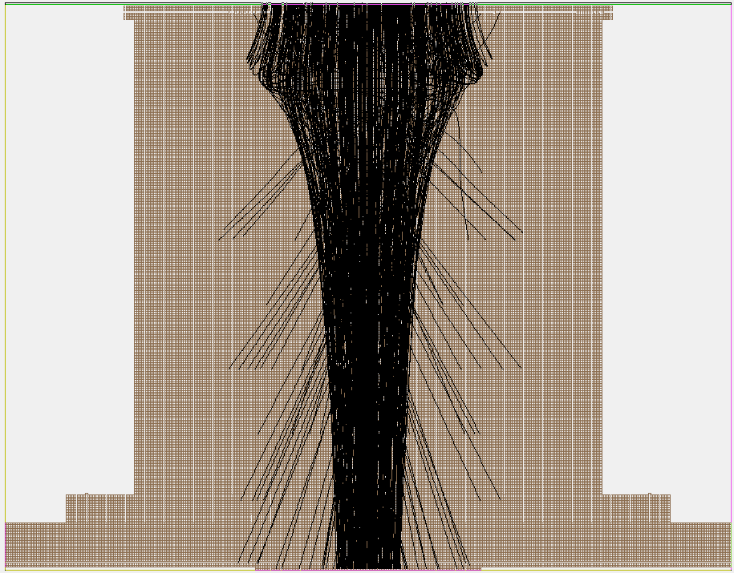
Path Examples for 0 deg from centerline XY Plane w/ 90eV electrons
SS = 0V
SS = -125V

Slide 7
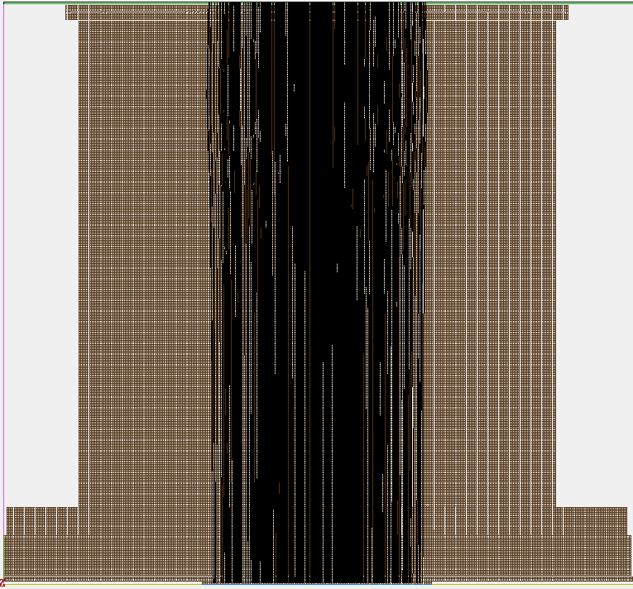
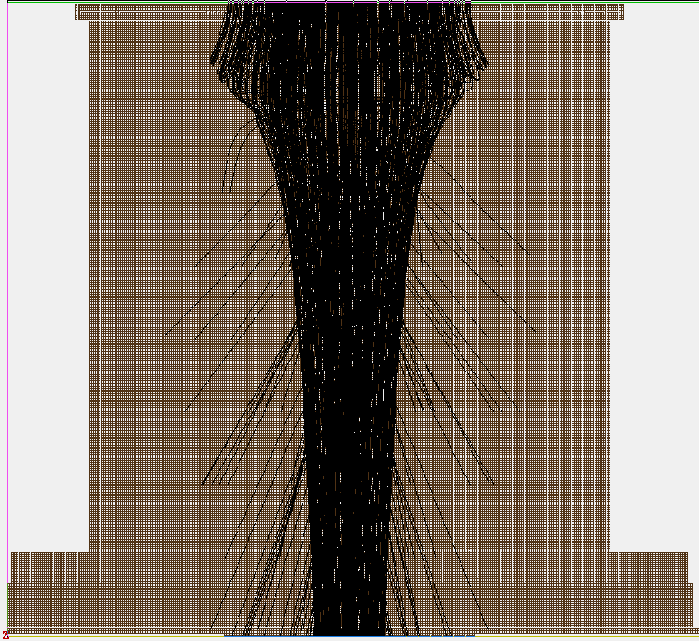
Path Examples for 0 deg from centerline ZY Plane w/ 90eV electrons
SS = 0V
SS = -125V

Slide 8
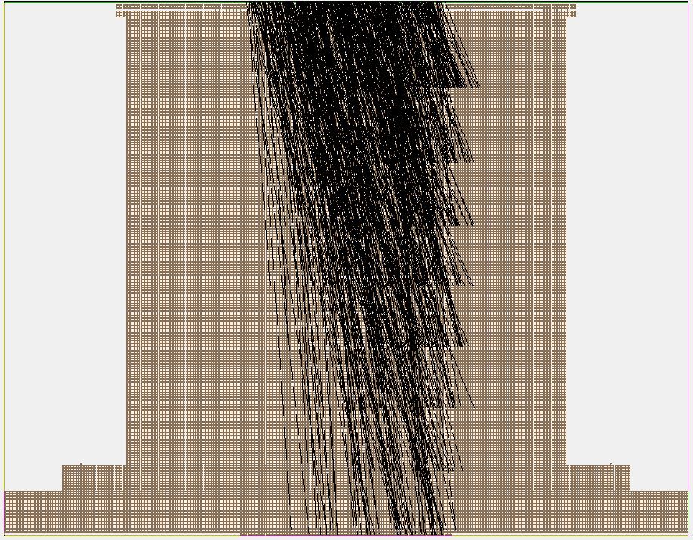
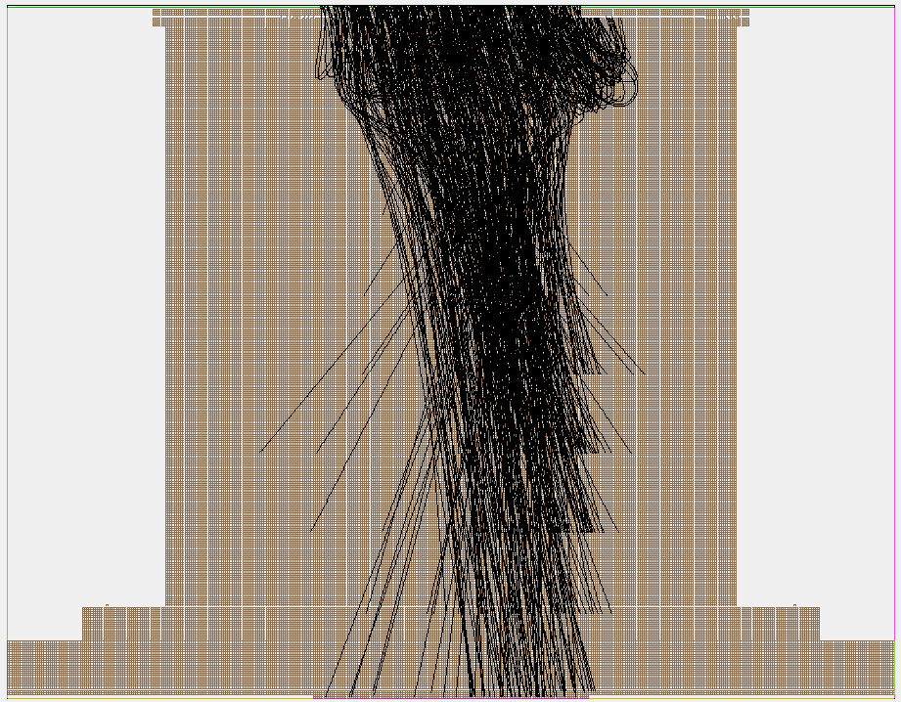
Path Examples for 20.75 deg from centerline XY Plane w/ 90eV electrons
SS = 0V
SS = -125V

Slide 9
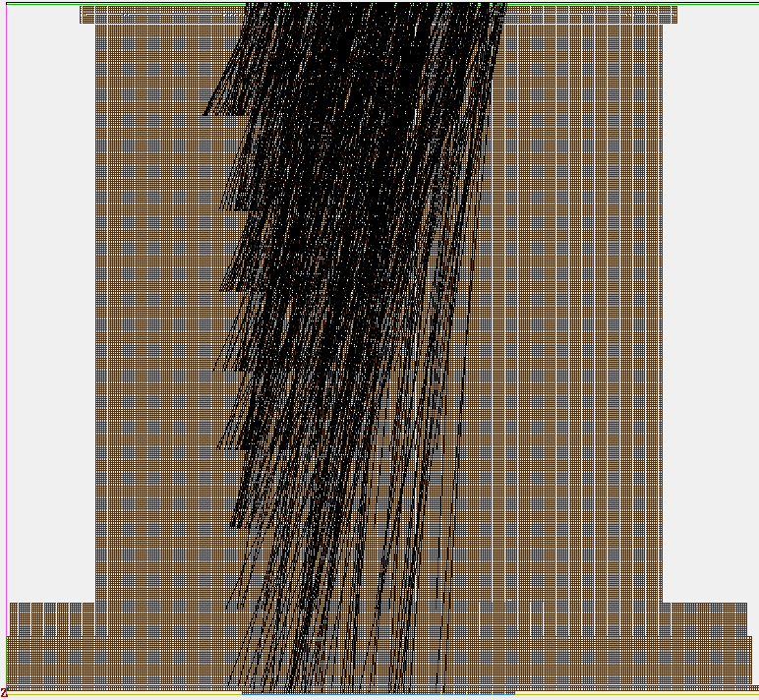
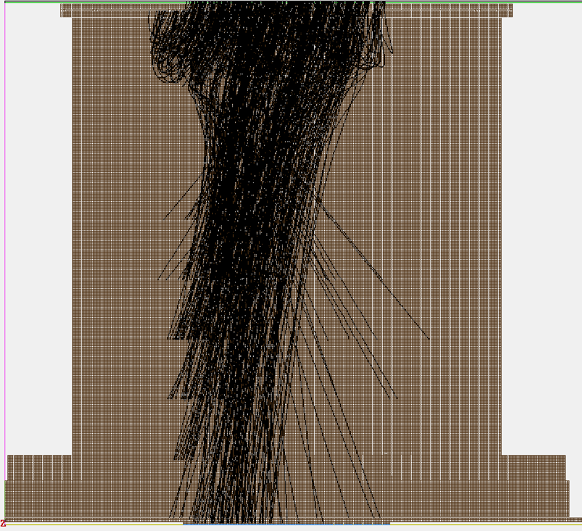
Path Examples for 20.75 deg from centerline ZY Plane w/ 90eV electrons
SS = 0V
SS = -125V

Slide 10
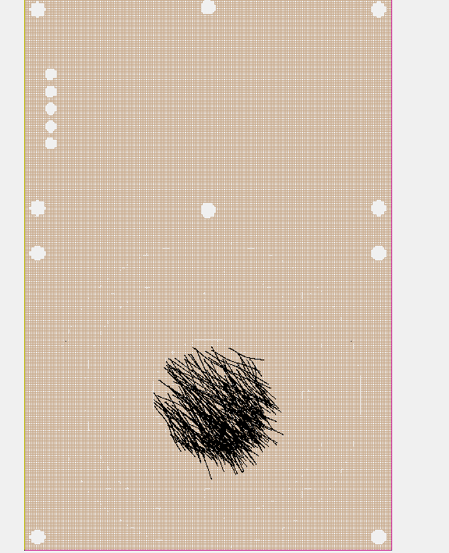
Particle Population Orientation
Particle directions are oriented toward the bottom left corner (45deg) and toward the viewer here
Then the 12deg angular range is applied.
This is a bottom-up view
12deg
12deg

Slide 11
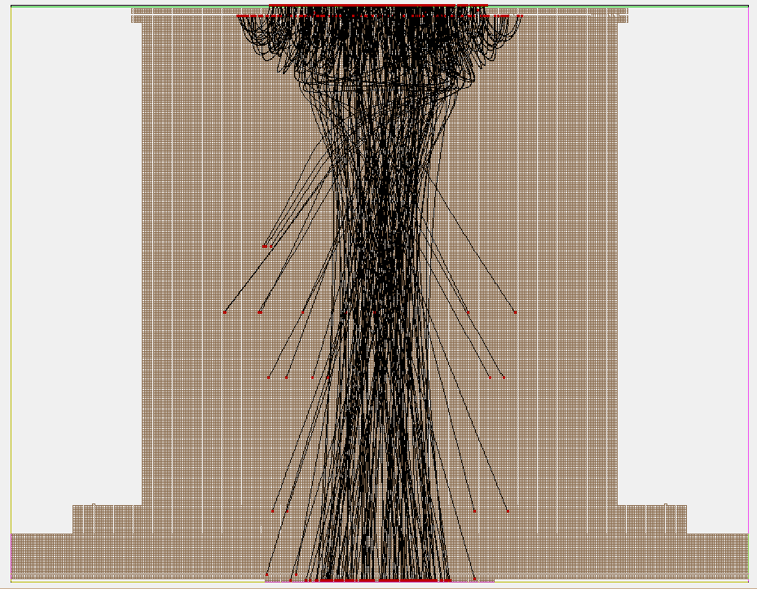
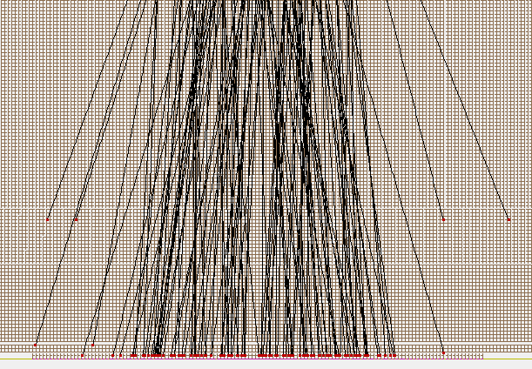
How are the counts determined good or bad?
Green Circle: Counted as impact on anode
Red Circle: Not counted as impact on anode
+y
y=0.2
In the data, if the ending position has a y=0.2,
then it has to have impacted the anode

Slide 12
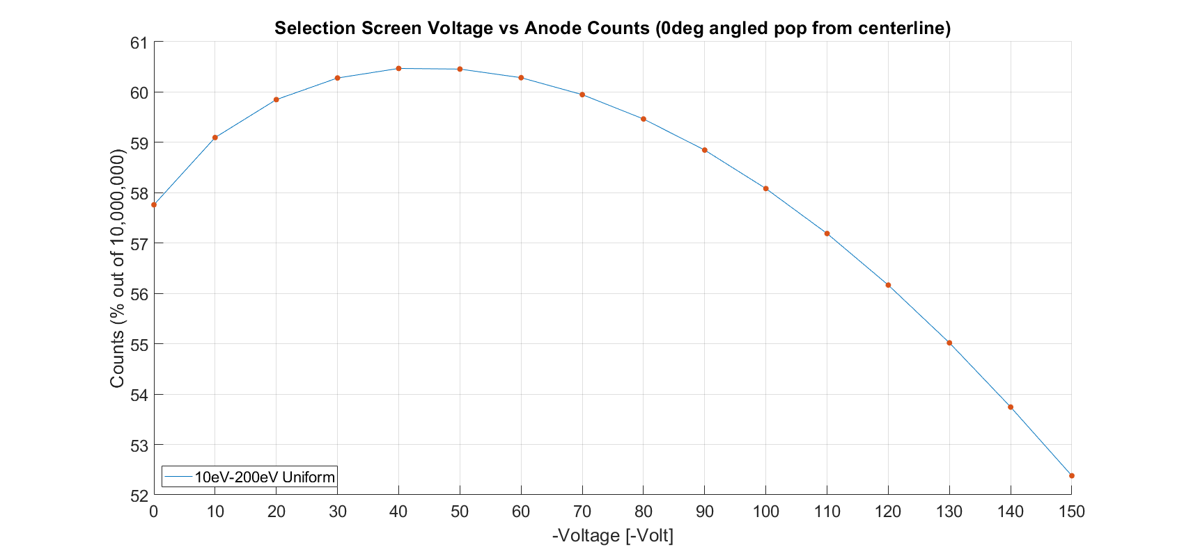
Results for 0deg from instrument centerline

Slide 13
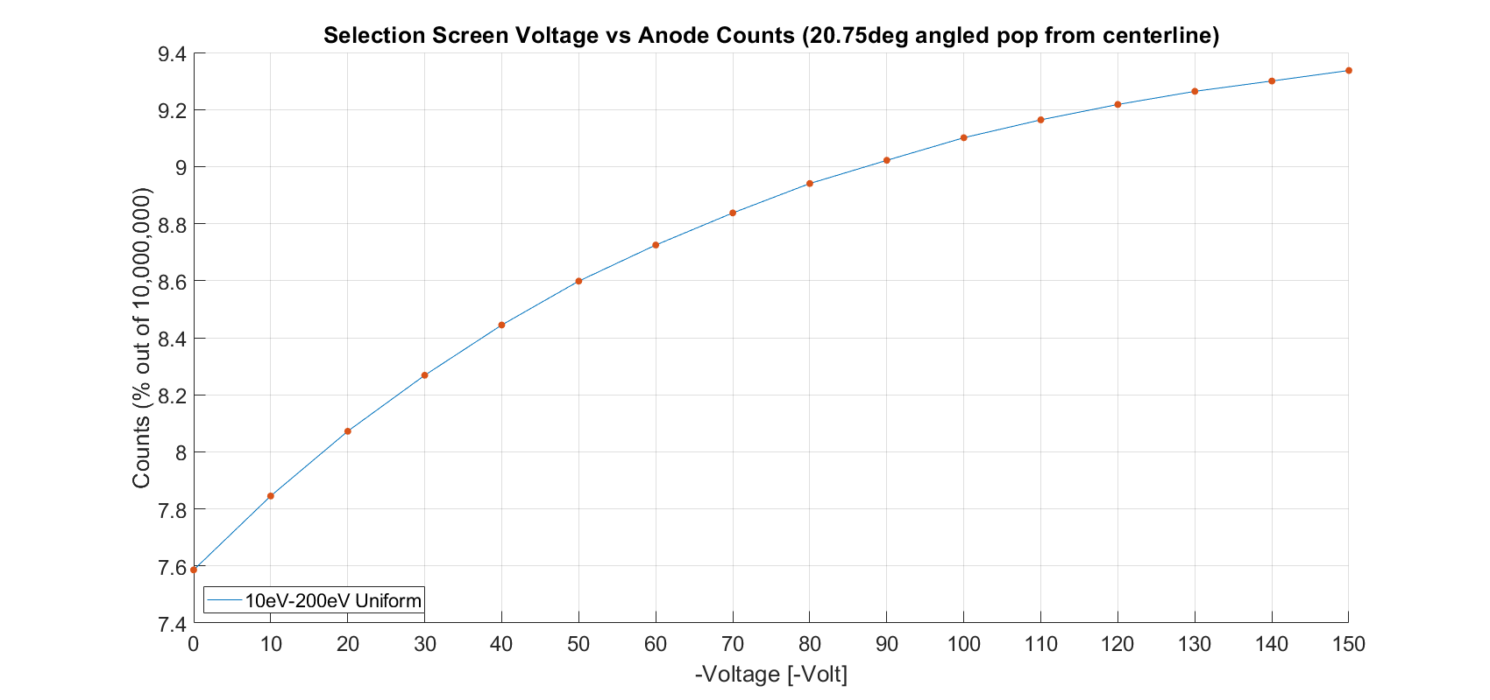
Results for 20.75 deg from instrument centerline

Slide 14
Results Cont. for 20.75 deg from instrument centerline
 | 0 deg | 20.75 deg
0V | 57.76063% | 7.58613%
10V | 59.09674% | 7.84531%
20V | 59.84993% | 8.07217%
30V | 60.27910% | 8.26849%
40V | 60.46913% | 8.44466%
50V | 60.45627% | 8.59851%
60V | 60.28524% | 8.72508%
70V | 59.94855% | 8.83759%
80V | 59.46494% | 8.94068%
90V | 58.84706% | 9.02199%
100V | 58.08284% | 9.10123%
110V | 57.19018% | 9.16389%
120V | 56.16627% | 9.21778%
130V | 55.01825% | 9.26388%
140V | 53.74301% | 9.30008%
150V | 52.37909% | 9.33699%
Counts as percentages compared to the 10mil population
Counts are registered only when they impact the anode face

